Slide 1
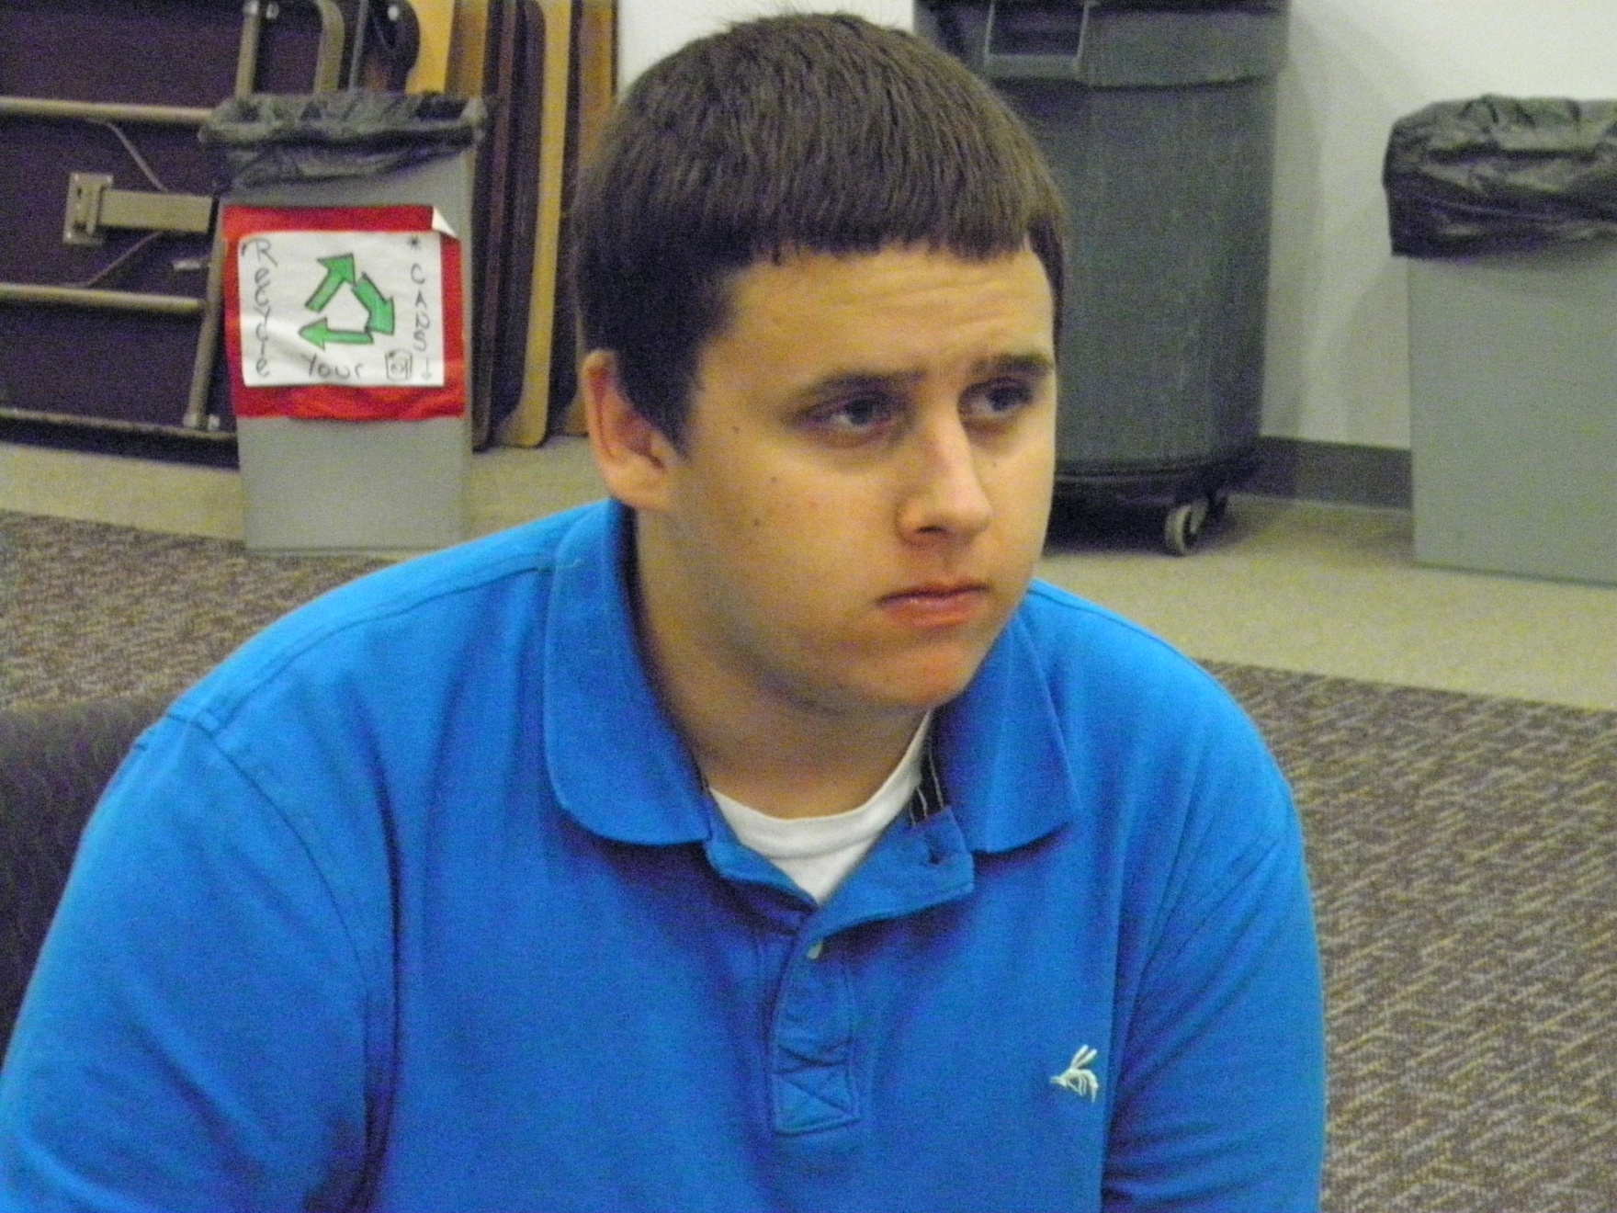
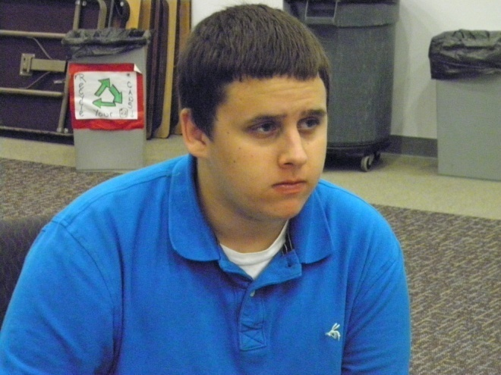
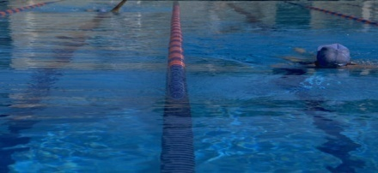
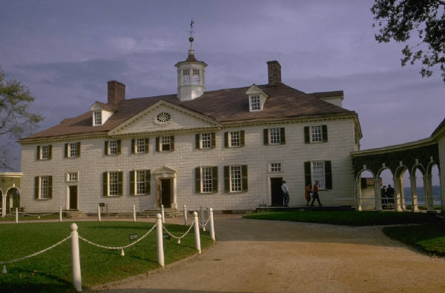
I Want You to Know
John
I often make the honor roll.
I am really good with my hands.
My sister and I were adopted at birth.
My favorite class is social studies.
My parents are both teachers.
I have severe migraines.
I was diagnosed with ADHD at age 4.
I have a learning disability.
I have difficulty putting my thoughts onto paper.
I am on the VDOE Youth Leadership Team.
I speak around the state on self-determination.
I scored a perfect score on my Geometry SOL.
Interests
Basketball
Softball
Video Games
Computer Games
Youth Groups
Special Olympics (Unified)
Learning Styles
Auditory/Kinesthetic
I want to live in a big house with a pool.
Accommodations that Work
Extended time on assignments
Scribe
10 problems in math per night
Water Breaks
Clinic Visits
Study Guides and Back-up Notes
My college choice is John Tyler.
My career interest is in
Criminal Justice.

